Slide 1

Working With Microsoft Word 2016
Jack Castillo
Keith Morgan
Right Click and Select “See all Slides” to navigate to a specific lesson

Slide 2
Course Overview
Page and Text Layout
Formatting and Styles
Tables
Headers, Footers, Lists
Proofing Tools
Importing Resources, Charts and Word Art

Slide 3
What do you hope to get out of this class?

Slide 4
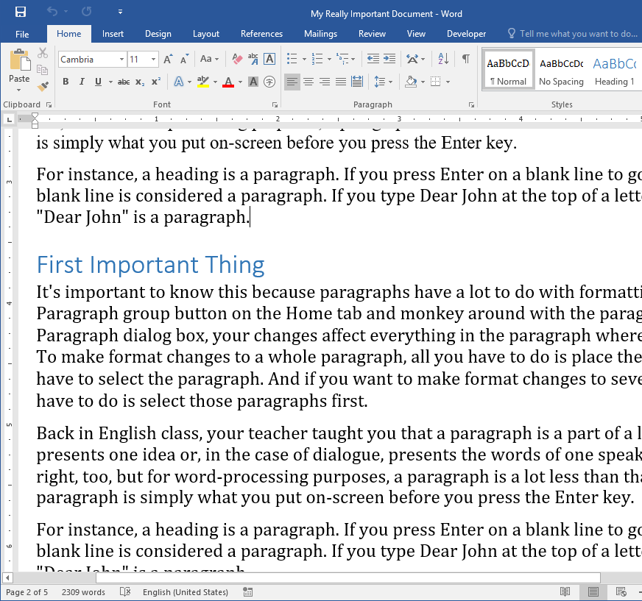
The Word Screen
Ribbon
Fonts
Paragraph Formatting
Styles
Document Area
Ruler
Page and Word Count

Slide 5
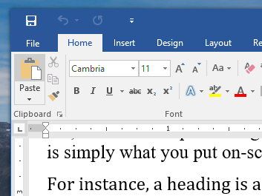
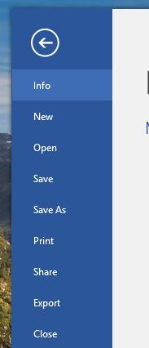
File Management
Ctrl + N New Document
Ctrl + O Open
Ctrl + S Save
Ctrl + F4 Close

Slide 6
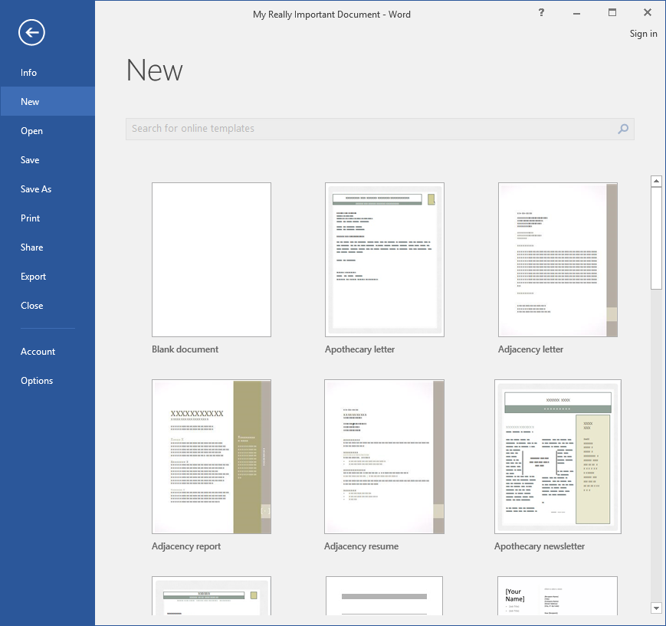
Creating a New Document
Completely blank
or
Many templates available
Notes:
We should look at creating a “Legal Document” template

Slide 7
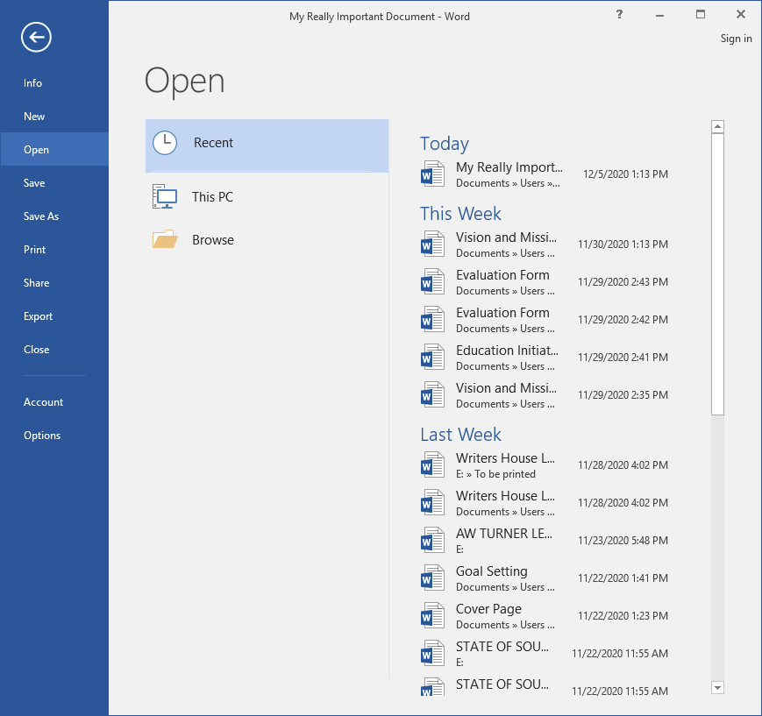
Opening a Document
Recent Documents
Browse
Users Folder
Select your SCDC#
Notes:
We should look at creating a “Legal Document” template

Slide 8
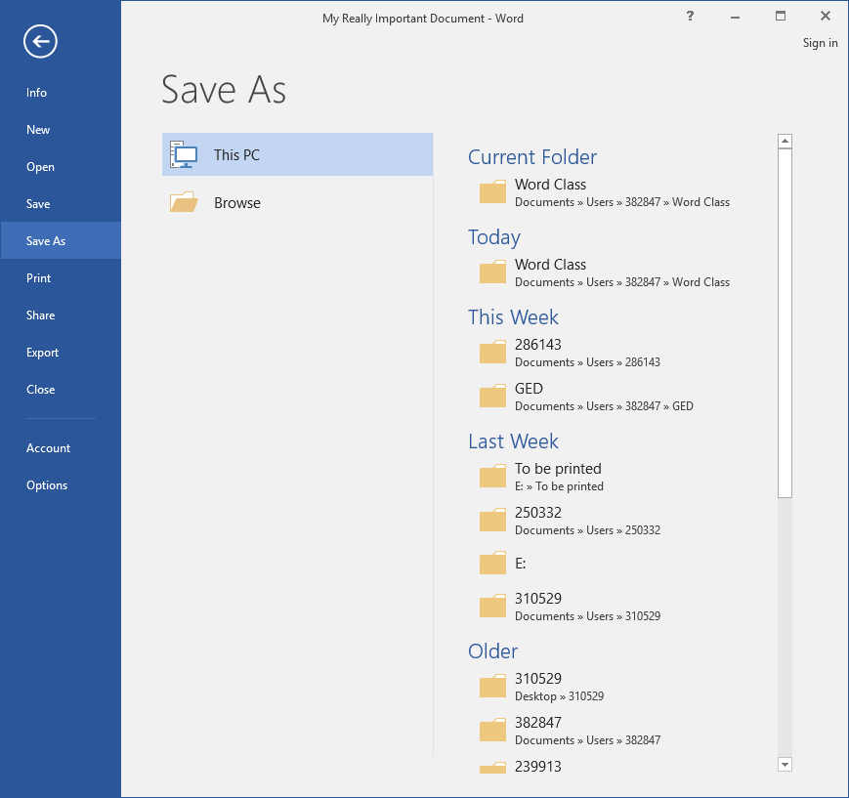
Saving Your Work
First time Save As
Later Save
Rename Save As
Ctrl + S
Notes:
We should look at creating a “Legal Document” template

Slide 9
Saving Your Work
Select your folder
or
Browse
Notes:
We should look at creating a “Legal Document” template

Slide 10
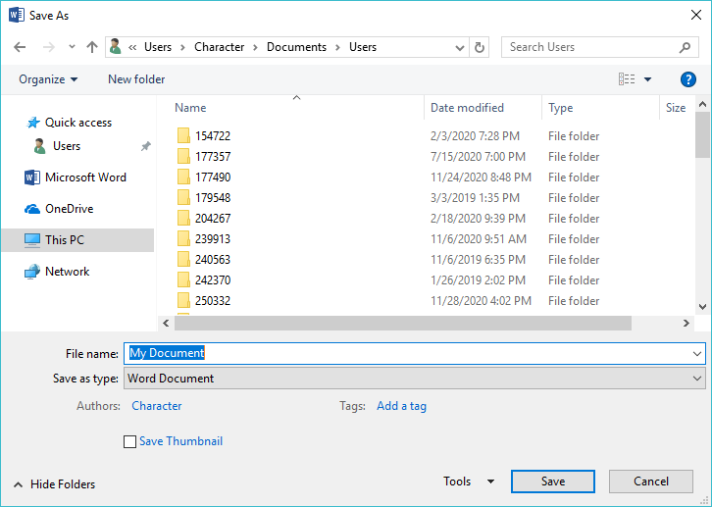
Saving Your Work
Make sure you are in your folder
Give the file a name
Click Save
Notes:
We should look at creating a “Legal Document” template

Slide 11
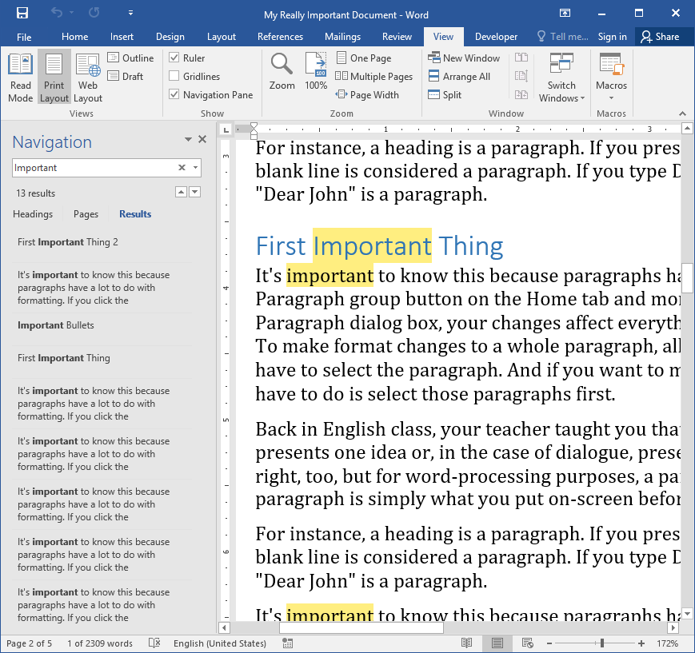
Navigating
PgUp / PgDn
Scroll Bar
View Ribbon
Zoom
Find

Slide 12
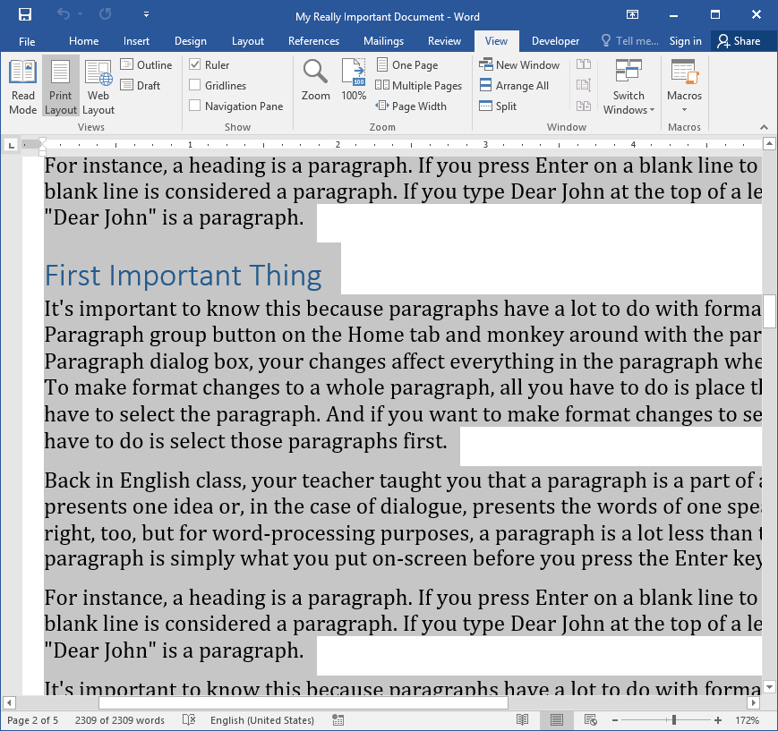
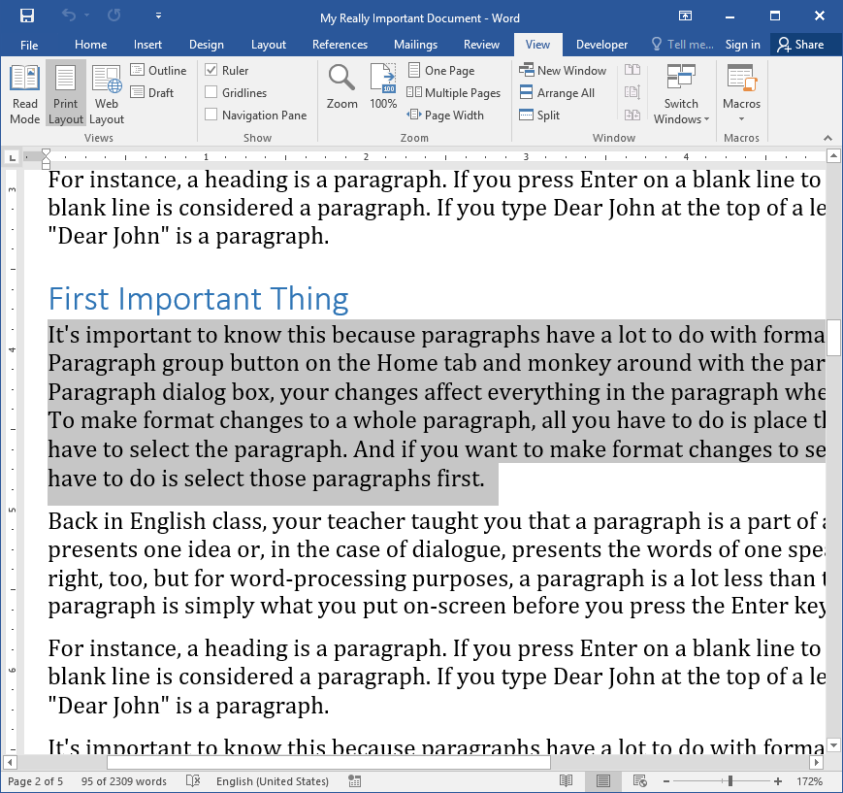
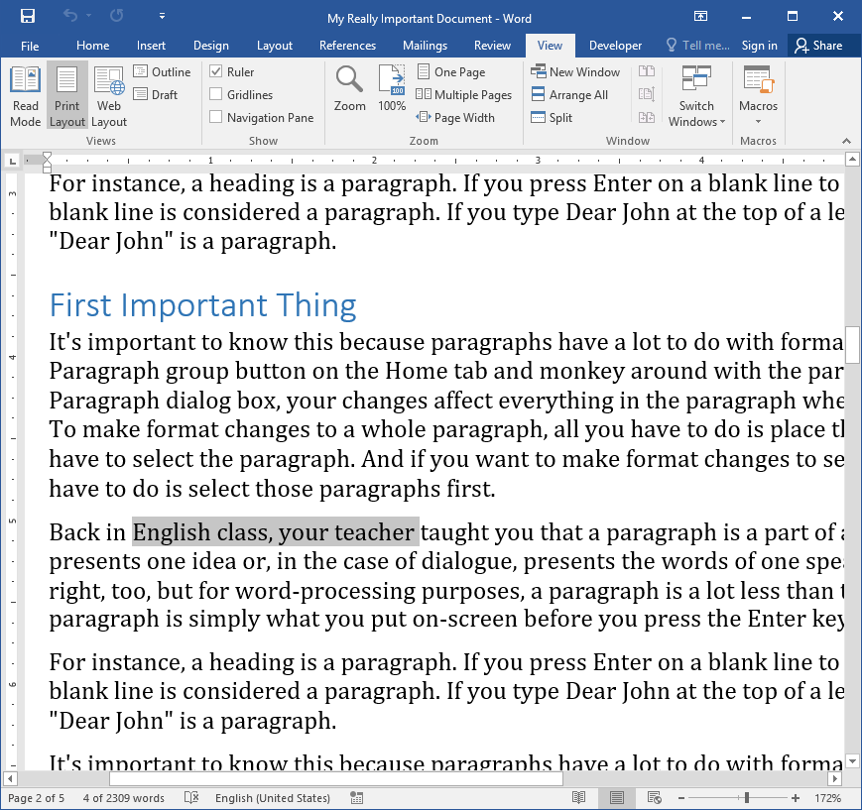
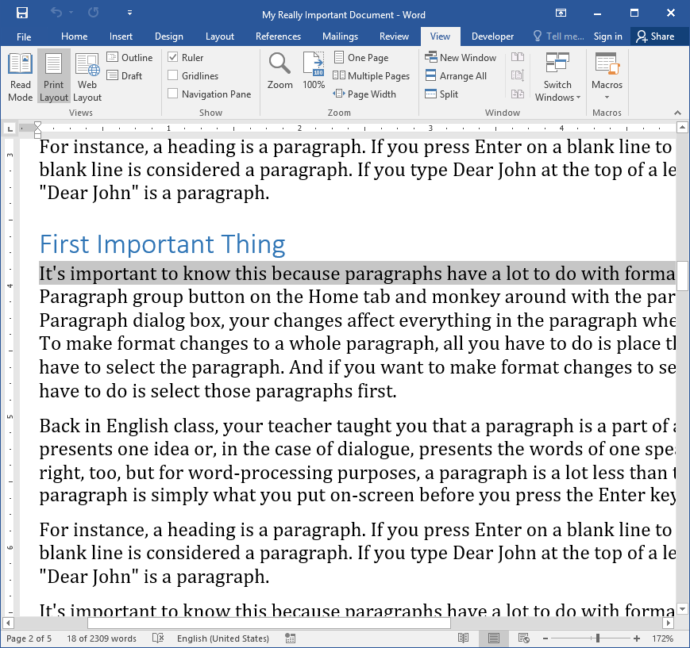
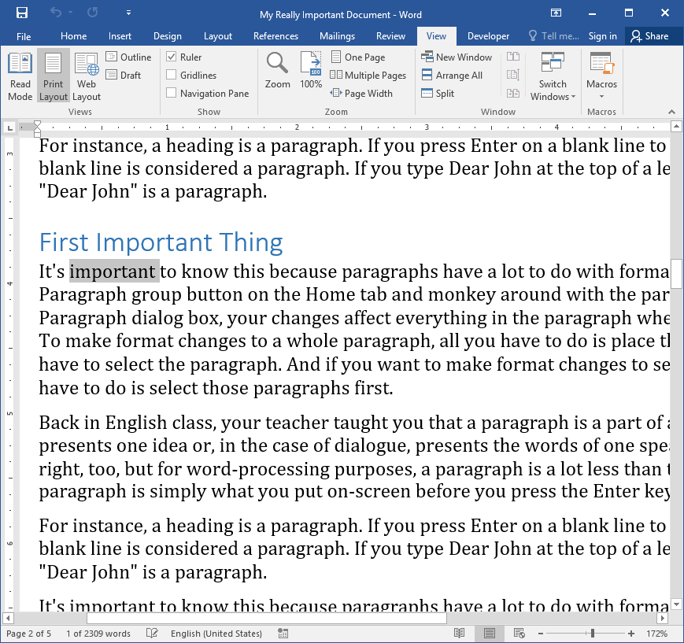
Selecting Text
One Word Double Click the word
One Line Single Click in margin
Paragraph Double Click in Margin
Section Click and Drag
Everything Ctrl + A
Notes:
We should look at creating a “Legal Document” template

Slide 13
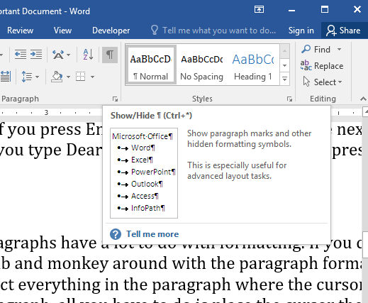
Need help?
Hover your mouse over any icon for details
Use the “Tell me what you want to do” box
Notes:
We should look at creating a “Legal Document” template

Slide 14
Review
Where is the Ribbon?
Where can you find how many words you’ve typed?
What is the keyboard shortcut for creating a new file?
What is the keyboard shortcut for saving a file?
Where should you save your documents?
What are three different ways you can navigate your doc?
How do you select a whole paragraph?
What information will you get from hovering on an icon?

Slide 15

What’s Next?
Page and Paragraph Layout

Slide 16
Working With Microsoft Word 2016
Jack Castillo
Keith Morgan Lesson 2

Slide 17
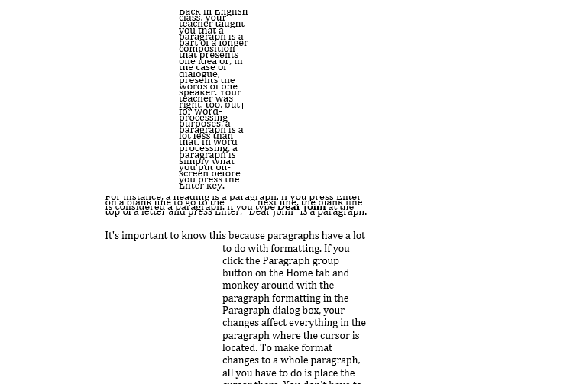
Anyone see anything wrong with this document?

Slide 18
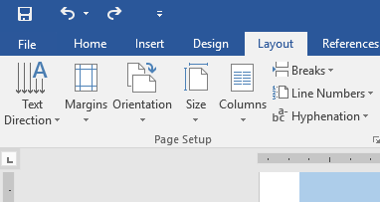
Page Layout
Margins
Orientation
Page Size
Columns
Page Breaks

Slide 19
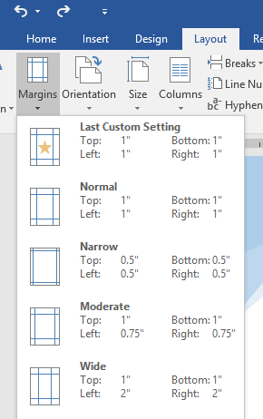
Margins
The amount of space around your document
Many options including custom
Be careful – some printers will have issues

Slide 20
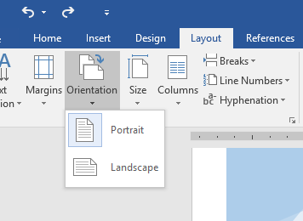
Orientation
How the paper is turned when it prints

Slide 21
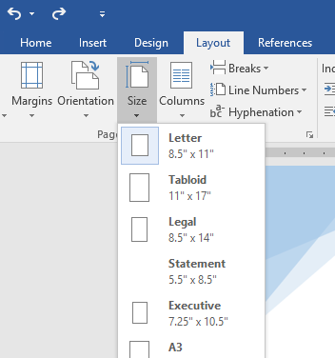
Page Size
The size of the paper you are printing on
Only select a different size if your printer supports that paper and if you have it available

Slide 22
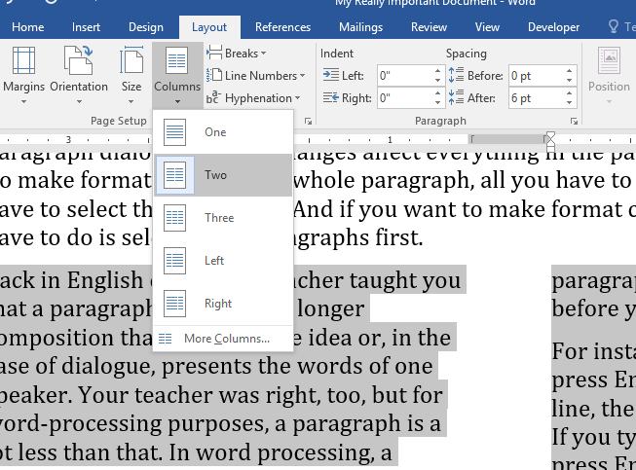
Columns
Break the page up into columns
More than 2 may get messy
Often used for newsletters

Slide 23
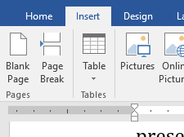
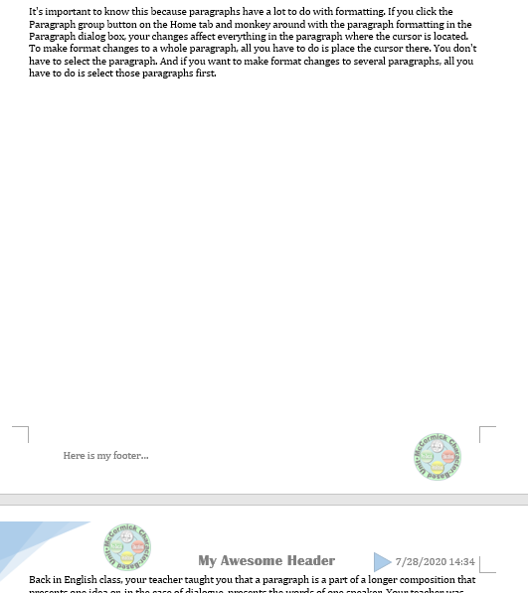
Page Breaks
Separate sections of a document
Blank pages can be inserted too!

Slide 24
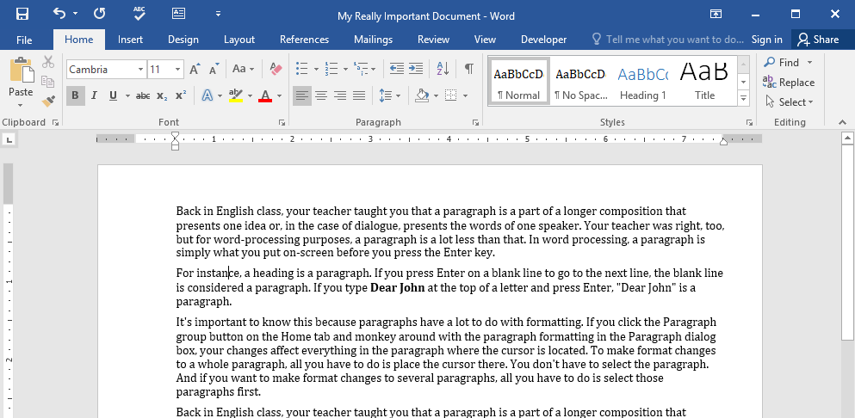
Paragraph Formatting
Alignment
Indenting
Line Spacing
Background Color
Quiz: How do you select a whole paragraph?

Slide 25
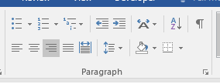
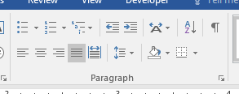
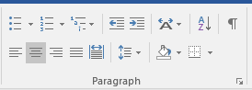
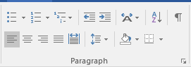
Paragraph Alignment
It's important to know this because paragraphs have a lot to do with formatting. If you click the Paragraph group button on the Home tab and monkey around with the paragraph formatting in the Paragraph dialog box, your changes affect everything in the paragraph where the cursor is located. To make format changes to a whole paragraph, all you have to do is place the cursor there. You don't have to select the paragraph. And if you want to make format changes to several paragraphs, all you have to do is select those paragraphs first.
It's important to know this because paragraphs have a lot to do with formatting. If you click the Paragraph group button on the Home tab and monkey around with the paragraph formatting in the Paragraph dialog box, your changes affect everything in the paragraph where the cursor is located. To make format changes to a whole paragraph, all you have to do is place the cursor there. You don't have to select the paragraph. And if you want to make format changes to several paragraphs, all you have to do is select those paragraphs first.
It's important to know this because paragraphs have a lot to do with formatting. If you click the Paragraph group button on the Home tab and monkey around with the paragraph formatting in the Paragraph dialog box, your changes affect everything in the paragraph where the cursor is located. To make format changes to a whole paragraph, all you have to do is place the cursor there. You don't have to select the paragraph. And if you want to make format changes to several paragraphs, all you have to do is select those paragraphs first.
It's important to know this because paragraphs have a lot to do with formatting. If you click the Paragraph group button on the Home tab and monkey around with the paragraph formatting in the Paragraph dialog box, your changes affect everything in the paragraph where the cursor is located. To make format changes to a whole paragraph, all you have to do is place the cursor there. You don't have to select the paragraph. And if you want to make format changes to several paragraphs, all you have to do is select those paragraphs first.
Which way the text flows
Left
Center
Right
Justified

Slide 26
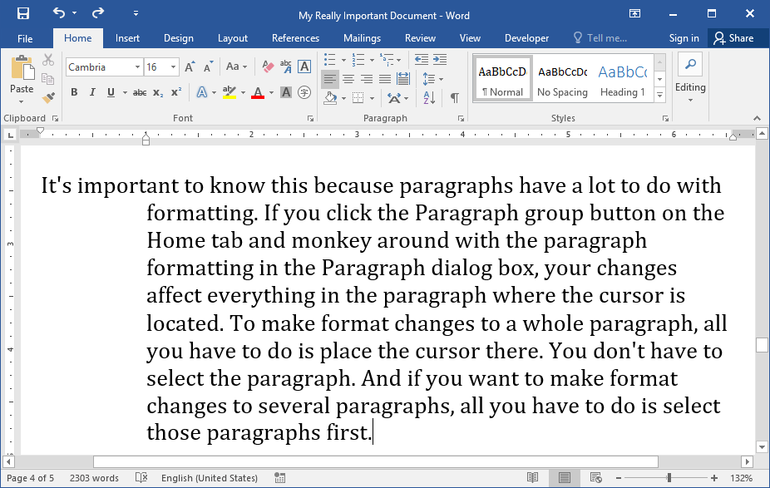
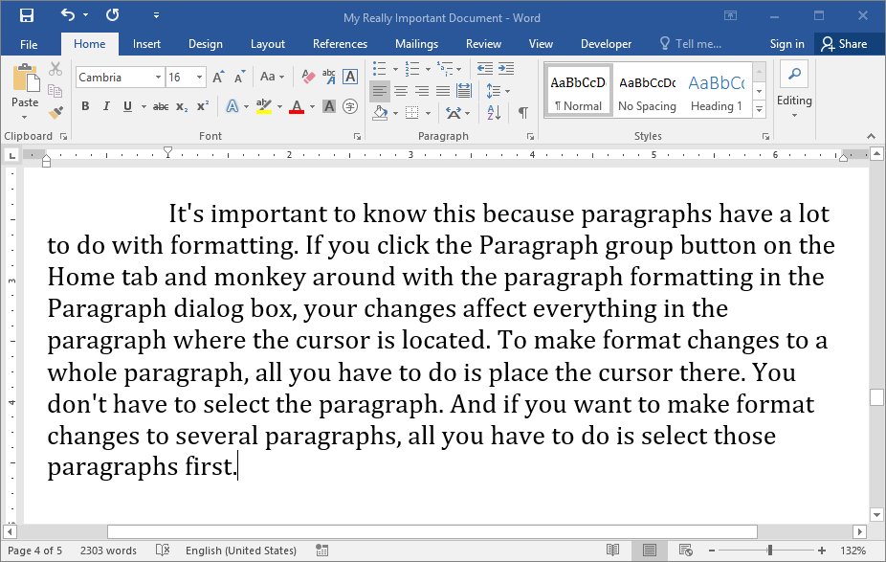
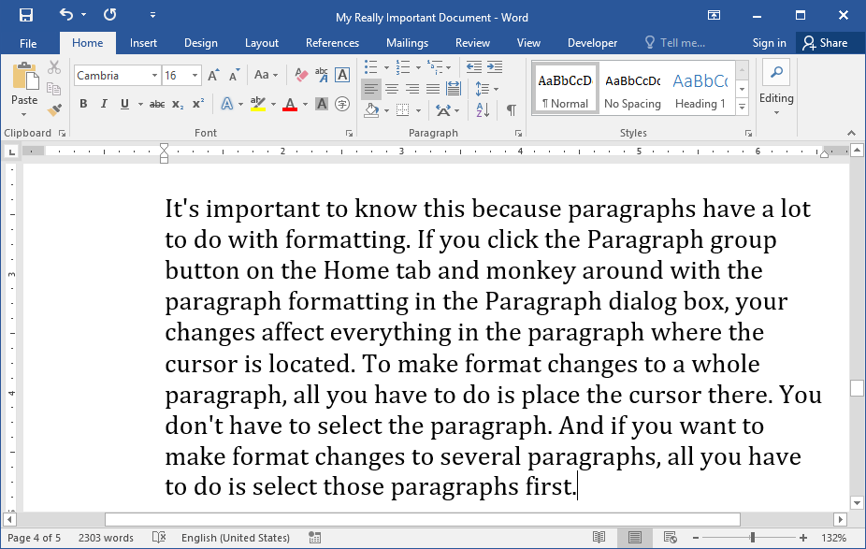
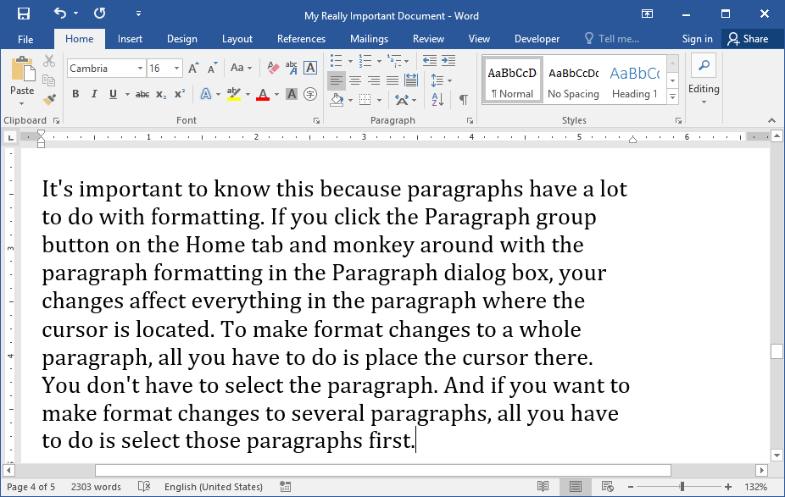
Paragraph Indention
Margin around the paragraph
Left Indent
Right Indent
First Line Indent
Hanging Indent

Slide 27
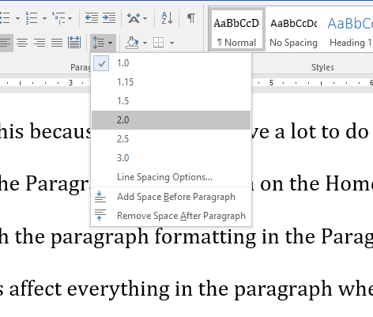
Line Spacing
The space between lines

Slide 28
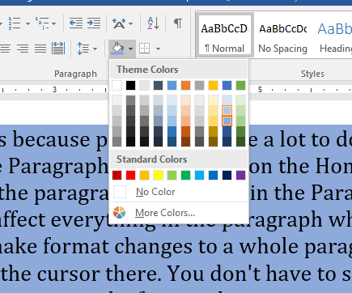
Background Color
Please don’t go crazy with this!

Slide 29
Review
What are page margins?
What methods are available to change the margins?
Can changing margins cause problems?
What are situations where you may want to change page orientation?
How many columns would you normally use if needed?
How is Justified alignment different from Left alignment?
What are the four different types of paragraph indention?
Can you choose custom background colors for text?

Slide 30
What’s Next?
Text Formatting and Styles

Slide 31
Working With Microsoft Word 2016
Jack Castillo
Keith Morgan Lesson 3

Slide 32
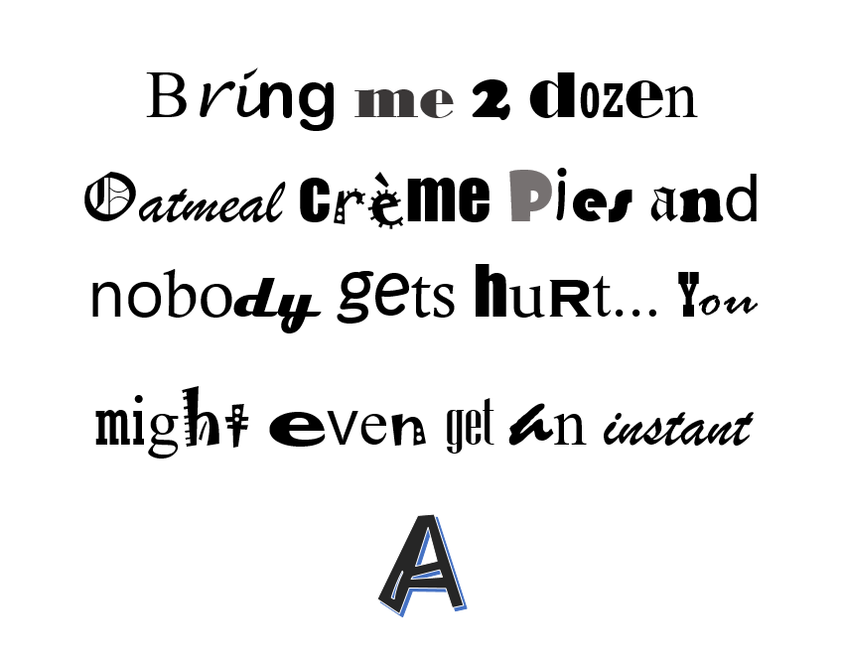
A message from your teacher...

Slide 33
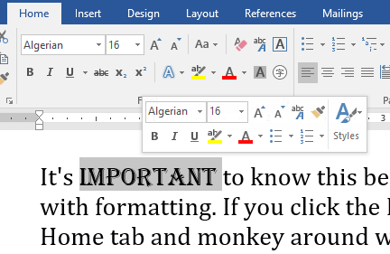
Fonts
Fonts
Font Size

Slide 34
Fonts
Arial - It's important to know this because paragraphs have a lot to do with formatting. Your changes affect everything in the paragraph where the cursor is located.
Calibri - It's important to know this because paragraphs have a lot to do with formatting. Your changes affect everything in the paragraph where the cursor is located.
Tahoma - It's important to know this because paragraphs have a lot to do with formatting. Your changes affect everything in the paragraph where the cursor is located.
Cambria - It's important to know this because paragraphs have a lot to do with formatting. Your changes affect everything in the paragraph where the cursor is located.
Arial
Calibri
Cambria
Tahoma
Serif vs Sans Serif
Friends don’t let friends use Times New Roman

Slide 35
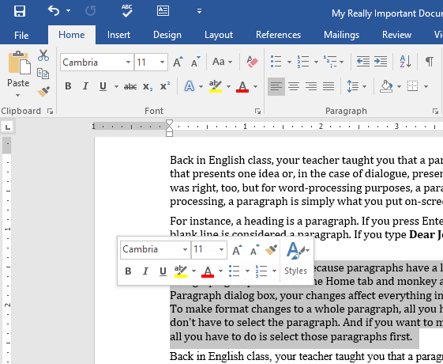
Fonts

Slide 36
Font Size
No smaller than 11pt

Slide 37
Text Formatting
Bold Ctrl + B
Italics Ctrl + I
Underline Ctrl + U
Strikethrough

Slide 38
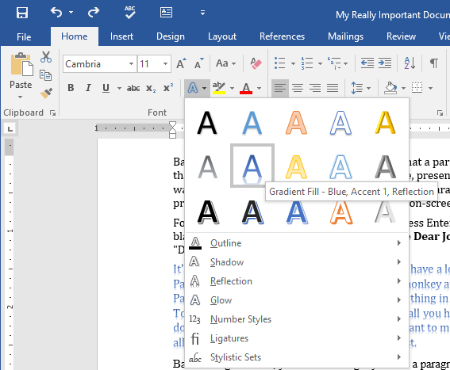
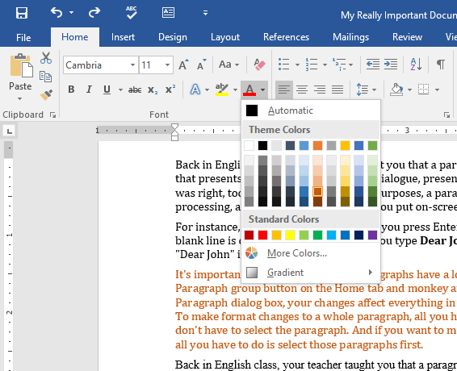
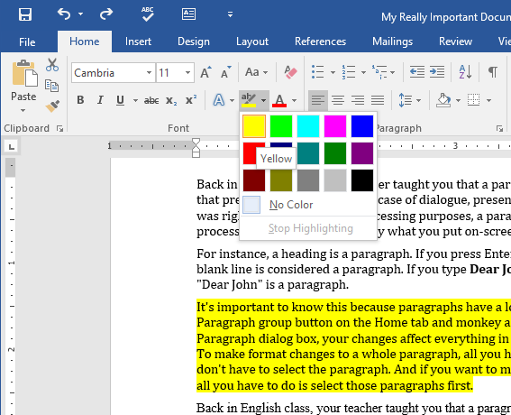
Text Formatting
Text Color
Highlight
Text Effects

Slide 39
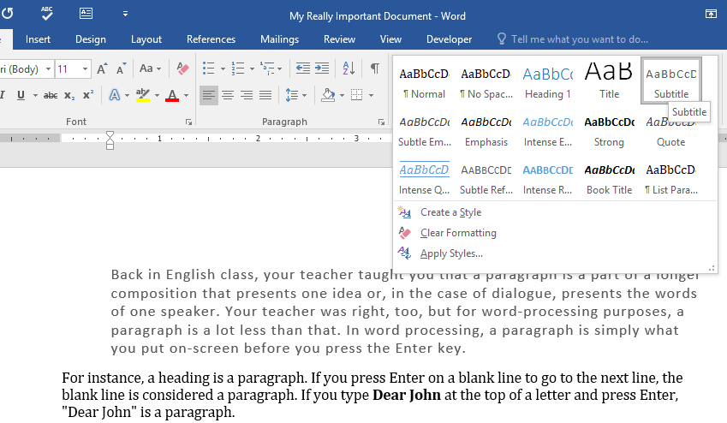
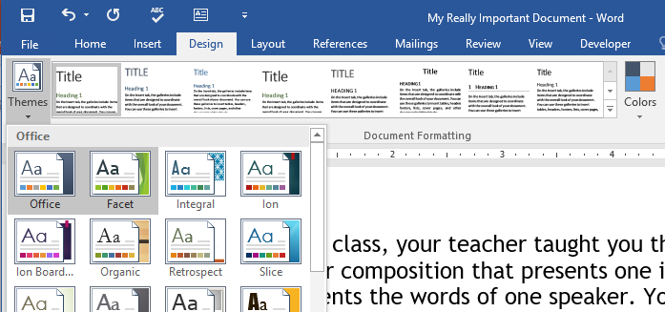
Word Styles
Pre-built styles from Microsoft
Multiple themes to choose from

Slide 40
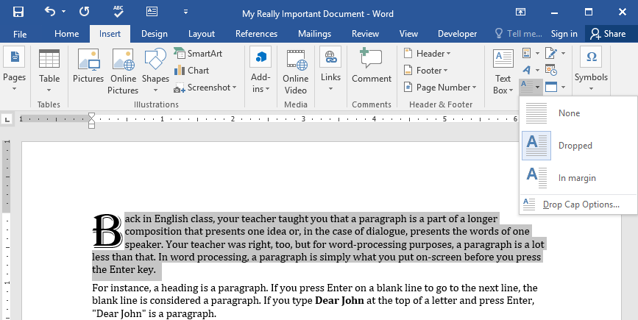
Drop Caps
Often used in books
Font and size can be changed

Slide 41
Questions
What are some fonts that are good defaults to use?
What is the minimum font size you should normally use?
What’s the keyboard shortcut for Italics?
Why might you want to use Drop Caps?
What are document themes?
How can you highlight important text in your document?
What makes a San Serif font easier to read?

Slide 42
What’s Next?
Tables

Slide 43
Working With Microsoft Word 2016
Jack Castillo
Keith Morgan Lesson 4

Slide 44
Tables are a pain in the ass...
Use sparingly

Slide 45
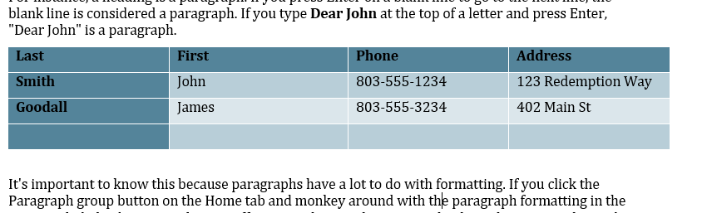
Parts of a Table
Header Row
Row Label
Border
Cell

Slide 46
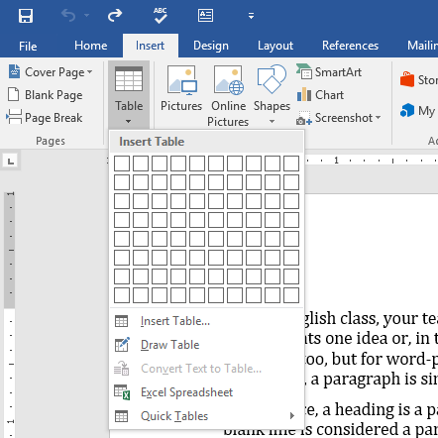
Adding a Table
Choose Number of Rows and Columns
Draw a Table
Insert from Excel

Slide 47
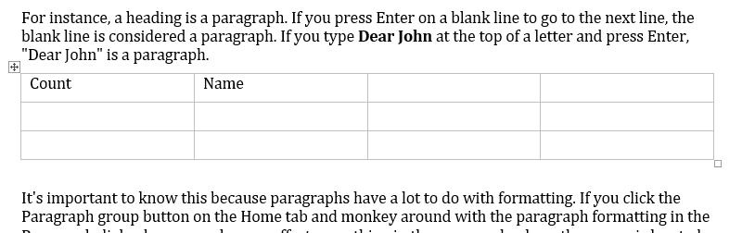
Navigating in the Table
Tab key is your best friend
Tab at the last row will add a new row
Shift + Tab goes back a cell
Phone
Address
Tab
Tab
Tab

Slide 48
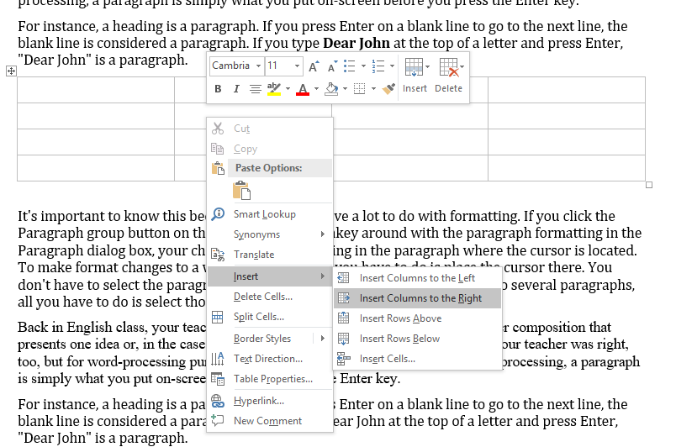
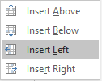
Adding Rows and Columns
Right Click
Use Insert button
Right Click
Select Insert
or

Slide 49
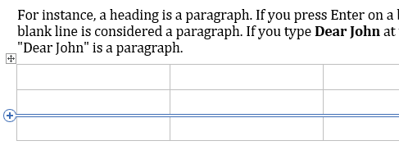
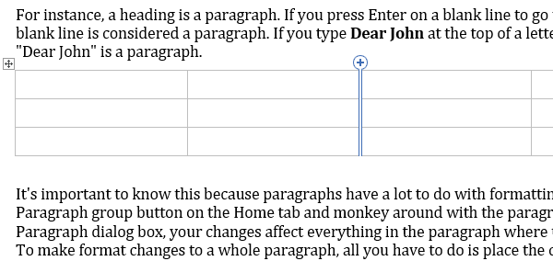
Adding Rows and Columns
Hover your mouse at the edge of the table (top or side)
Click the plus

Slide 50
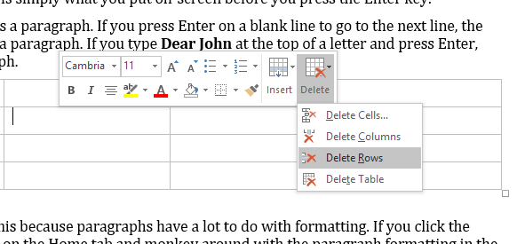
Deleting Rows and Columns
Right Click
Use Delete button
Multiple rows can be deleted at once by selecting them first

Slide 51

Adjusting Width and Height
Hover mouse over border
Cursor will change to or
Click and Drag
Not all cells can adjusted due to content size

Slide 52

Adjusting Width and Height
Click anywhere inside the table
Drag the handles in the ruler
Overall table size can be changed with the square handle in the bottom right

Slide 53


Merging Cells
Select multiple cells
Right Click
Select Merge Cells

Slide 54

Cell Alignment
Cell must be larger than the content
Vertical alignment only affects tall cells

Slide 55
Questions
What is a Table Cell?
Where is the Row Header?
Why would you want to use a table?
What are a few ways to add a table to a document?
How do you add a column to your table?
Can multiple rows or columns be deleted at the same time?
How do you change the size of the whole table?
Why would you want to merge cells?
Why might cell alignment not affect the text inside the cell?

Slide 56
What’s Next?
Advanced Tables

Slide 57
Working With Microsoft Word 2016
Jack Castillo
Keith Morgan Lesson 5

Slide 58

Table Tools
Table Styles
Borders
Cell Sizing
Alignment

Slide 59

Table Styles
Multiple Options
Be Careful with Shading
Style Options Allow Customization

Slide 60






Table Styles

Slide 61

Table Style Options
Header Row
Total Row
Banded Rows
First Column
Last Column
Banded Columns

Slide 62



Borders
Select the Table
Choose Border Styles
Click Borders
Select All Borders

Slide 63

Border Painter
Click into the table
Click Design
Choose Border Style
Click Border Painter
Click on border you want to change

Slide 64

Cell Sizing
Ruler
Ribbon
Row / Column Handles
AutoFit will try best fit

Slide 65

Alignment
Alignment only effects text if the cell is large enough

Slide 66

Text Direction
Very useful for row headers
Each click will cycle the direction

Slide 67

Cell Margins
Defaults are normally good
Table and cell margins can be changed

Slide 68



Sorting Data
Some functionality from Excel
Sort on multiple columns

Slide 69
Questions
What are four important options in Table Tools?
How do you change or add borders on your table?
On what Ribbon option would you find the Border Painter?
What are some ways to change the cell size?
Why would cell alignment not affect the text?
Why would you need to change the direction of text?
Would you normally change the default margin settings?
What are some different ways you may sort columns/rows?

Slide 70
What’s Next?
Headers, Footers and Lists

Slide 71
Working With Microsoft Word 2016
Jack Castillo
Keith Morgan Lesson 6

Slide 72


Headers & Footers
Common elements across all pages
In the top and bottom pages margins

Slide 73

Headers & Footers
Double Click Header or Footer to edit
Double Click outside to exit

Slide 74

Themes
Multiple themes for both Headers and Footers

Slide 75

Elements
Page Numbers
Date/Timestamp
Document Info
Pictures
Shapes

Slide 76
Header & Footer Options
Different 1st Page
Different Even & Odd Pages

Slide 77

And here we is what we end up with…

Slide 78

Lists
Bullets
Numbered List
Outlines

Slide 79
Working with Lists
Choose list type
Enter for new items
Tab to move over
Shift+Tab to move back
Shift+Enter to start a new line but not a new item

Slide 80



Customizing Lists

Slide 81
Questions
Do Headers and Footers apply to all pages by default?
How do Header and Footer themes affect your document?
What are some elements you can add to Headers / Footers?
Can you have a different Header or Footer on specific pages?
What types of lists are available in Word?
Why would you want to use a list?
How do you start a new line in a list item?
How do you move a list item back a level?
Are there different options available for lists?

Slide 82
What’s Next?
Table of Contents and Proofing Tools

Slide 83
Working With Microsoft Word 2016
Jack Castillo
Keith Morgan Lesson 7

Slide 84

Typos
See the red squiggly line
Right click
Choose correct or Give Up
Be careful with Add to Dictionary!

Slide 85


Document Check
Walks through all grammar and spelling errors in the document

Slide 86

Grammar
See the blue squiggly line
Right Click
Choose correct
Just because Word is smart doesn’t mean it will catch everything.

Slide 87

Thesaurus
Right Click any word
Goto Synonyms
Choose “better” word

Slide 88

Thesaurus
Lists multiple meanings
Synonyms
Antonyms
Speech
Definitions

Slide 89

Table of Contents
Add headings to your document
Place Cursor
References Tab
Table of Contents

Slide 90

Table of Contents
Update Page Numbers
Update entire table

Slide 91

Table of Contents
Ctrl + Click any item to go there

Slide 92
Questions
What does a red squiggly line mean?
What does a blue squiggly line mean?
How can you find another word with a similar meaning?
What additional information does the Word thesaurus provide?
What must you have in your document for a Table of Contents to work?
Where do you go to insert a Table of Contents?
How do you update the TOC?

Slide 93
What’s Next?
Importing Resources

Slide 94
Working With Microsoft Word 2016
Jack Castillo
Keith Morgan Lesson 8

Slide 95
Tables
Name | Address | Phone
John Smith | 123 Main St | 803-555-1234
Adam Williams | 532 Adam St | 803-555-5234
Susie Crawford | 9853 N. West St | 803-555-6435
Clint Adams | 321 Straight Way | 803-555-2231
Insert and Edit
Import from Excel

Slide 96

Pictures
Corrections
Artistic Effects
Styles
Borders
Crop

Slide 97

Screenshots
Built in Screenshot
Snipping Tool
Print Screen

Slide 98

Shapes
Drawing Tools
Click inside to add text
Start
Choose

Slide 99

SmartArt
First
Second
Other stuff
One
Final
Yeesh…
Two

Slide 100

Charts

Slide 101

Copy / Paste Resource
Images
Text
Drag and Drop works too!

Slide 102
WordArt
Fancy Text
Sketchy Text
Combine Word Art with Shape Styles for more awesomeness
Reflectety Text
Blocky Text

Slide 103

Equations
$${\left(1+x\right)}^{n}=1+\frac{nx}{1!}+\frac{n\left(n−1\right)x^{2}}{2!}+…$$
$${\left(x+a\right)}^{n}=\sum_{k=0}^{n}{\left({n \atop k}\right)x^{k}a^{n−k}}$$
$$\cos{α}+\cos{β}=2\cos{\frac{1}{2}\left(α+β\right)}\cos{\frac{1}{2}\left(α−β\right)}$$
Prebuilt
Draw Equation
Symbols
Structures

Slide 104
Questions
What is a resource?
What are some resource types you can import?
Why should you resize pictures with Shift?
Can you add text to all shapes?
How do you edit the data in a chart?
Can you modify parts of some shapes?
What is SmartArt?
How can you build a custom equation?

Slide 105
What’s Next?
Final Exam

Slide 106
Working With Microsoft Word 2016
Jack Castillo
Keith Morgan Review and Final

Slide 107
Test Review
Where would you find margin options?
How do you replace a word in your document with a synonym?

Slide 108
Test Review
How do you set the alignment of a paragraph?
How do you access Headers and Footers?
How do you change the font?

Slide 109
Test Review
If you wanted to know how many words were in your document, where you would look?
How do you resize an image and keep the ratio of width to height the same?

Slide 110
Test Review
Where would you click to find all grammar and spelling errors?
How do you add a list?
What are some options for inserting a table in your document?

Slide 111
Test Review
How do you save a document using the keyboard?
How do you select a single paragraph?
What are some options for inserting a table in your document?

